Slide 1
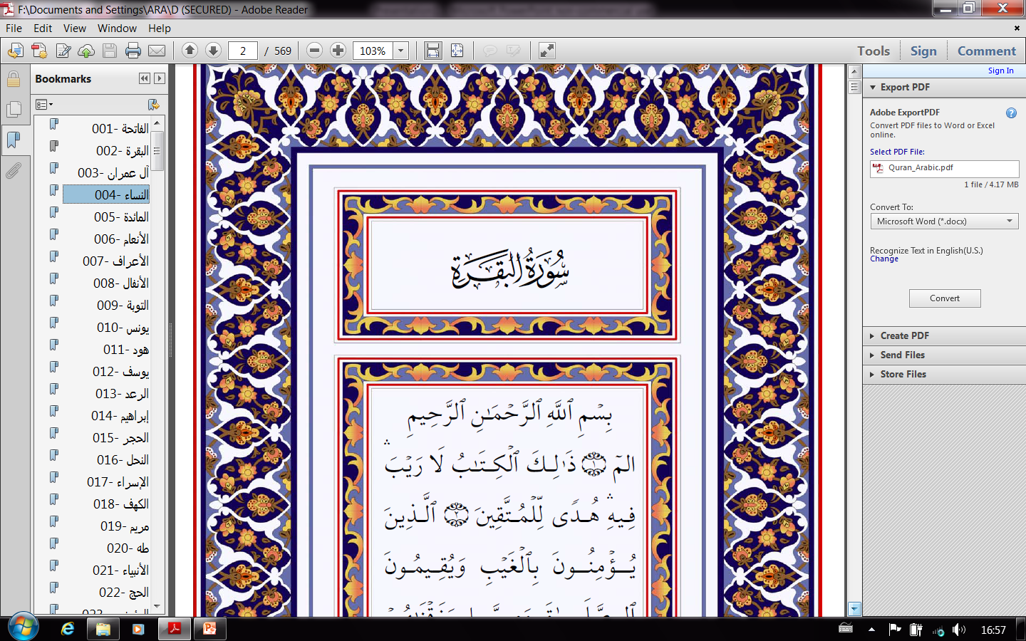
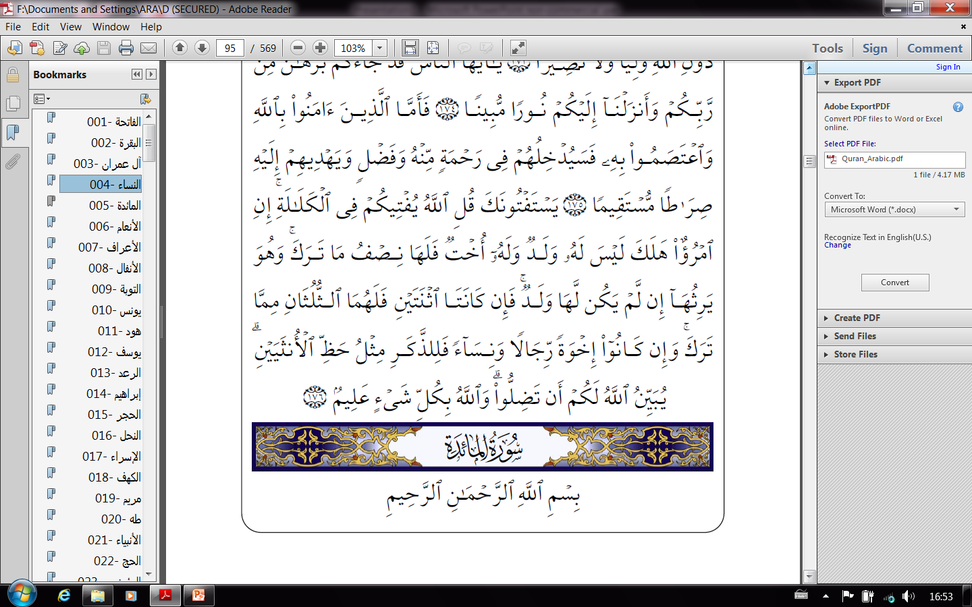
Quranic Inheritance
Law and Will
PowerPoint presentation of an interpretation by
M. Al-Qaisey
^{M.Al_Qaisey973@yahoo.com}
17 February 2014
Monday 17 Rabia’ Al-Thani 1435

Slide 2
Quranic Inheritance (Irth ) Law and Will (Wasiyah )
Source and Chronology of Islamic Will and Inheritance Rules.
Witnessing a Wills (Wasiyah) and Guardianship Rules.
Islamic Inheritance (Irth) Distribution (Qisma) Rules.
Witness Oath, Contesting Wills and Inheritance Shares.
Reasons for Revelation of Inheritance Ayahs & Pbuh Verdicts
Islamic Inheritance Software: Test Cases & Cases, 1, 2, 3 & 4.
Summary: A. Typical “Irth” Cases B. Special “Kalala” Cases.
Conclusions: A. Chronology, B. Status of Will in Quran, C. Frequent Questions and Answers, D. Mathematics.
.

Slide 3
Prophet Muhammad Ibn Abdu-Allah Al-Qureshi (Pbuh) born in Mecca, circa 571 AD.
Received (Pbuh) his first revelation “Surah” through Archangel Gabriel, circa 610 AD.
The Prophet (Pbuh) emigrated with his disciples “Sahabah” to Medina in 622 AD.
Seventy out of the 114 Quranic Chapters “Surahs” were revealed during the first 12 revelation years in Mecca, and 44 “Surahs” during the 10 revelation years in Medina.
God Messenger (Pbuh) died age 61 in Medina in 632 AD (Age 63 Lunar years).
The 50th Surah (Chapter 17) and the 87th Surah (Chapter 2) includes verses on making and witnessing Wills, and guidelines to guardians.
The 92nd Surah (Chapter 4) includes the main guidelines to guardians and Will executioners, prescribes heirs hierarchy and their apportioned inheritance shares.
The 112th Surah (Chapter 5) includes verses on the fundamentals of making, witnessing, executing and contesting a Will.
1A. Source of Islamic Will and Inheritance Laws
1B. Chronology vs. Quranic Order of Inheritance “Surahs”

Slide 4
No. of Ayahs in Surah
0 Mecca 10 Medina 20 Years

Slide 5
No. of Ayahs in Quranic Surah
Surah’s Number in Quranic Sequence

Slide 6
Quranic Inheritance (Irth ) Law and Will (Wasiyah )
Source and Chronology of Islamic Will and Inheritance Rules.
Witnessing a Will (Wasiyah) and Guardianship Rules.
Islamic Inheritance (Irth) Distribution (Qisma) Rules.
Witness Oath, Contesting Wills and Inheritance Shares.
Reasons for Revelation of Inheritance Ayahs & Pbuh Verdicts
Islamic Inheritance Software: Test Cases & Cases, 1, 2, 3 & 4.
Summary: A. Typical “Irth” Cases B. Special “Kalala” Cases.
Conclusions: A. Chronology, B. Status of Will in Quran, C. Frequent Questions and Answers, D. Mathematics.
.
s.

Slide 7
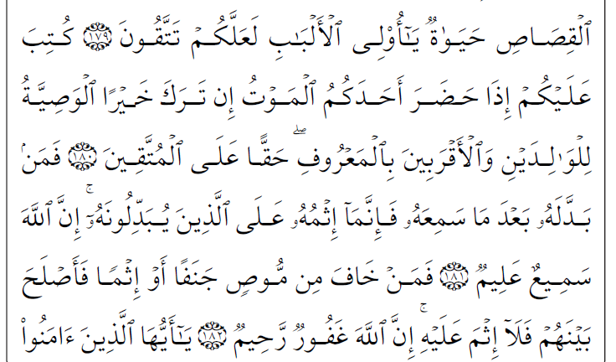
87th Surah 2: 180-182
2A. Muslim’s Obligation to Write a Will
Prescribed for you, when any of you is visited by death, and he leaves behind some goods, is
to make testament in favour of his parents and kinsmen honourably -- an obligation on the God-fearing. 2:180
Then if any man changes it after hearing it, the sin shall rest upon those who change it; surely God is All-hearing, All-knowing. 2:181
But if any man fears injustice or sin from one making testament, and so makes things right between them, then sin shall not rest upon him; surely God is All-forgiving, All-compassionate. 2:182
2B. Cautions to Will’s Witnesses

Slide 8
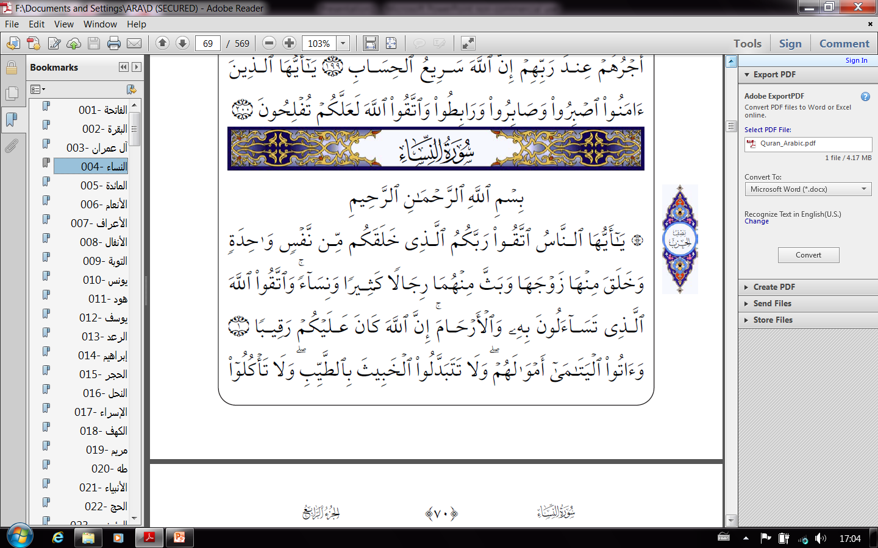
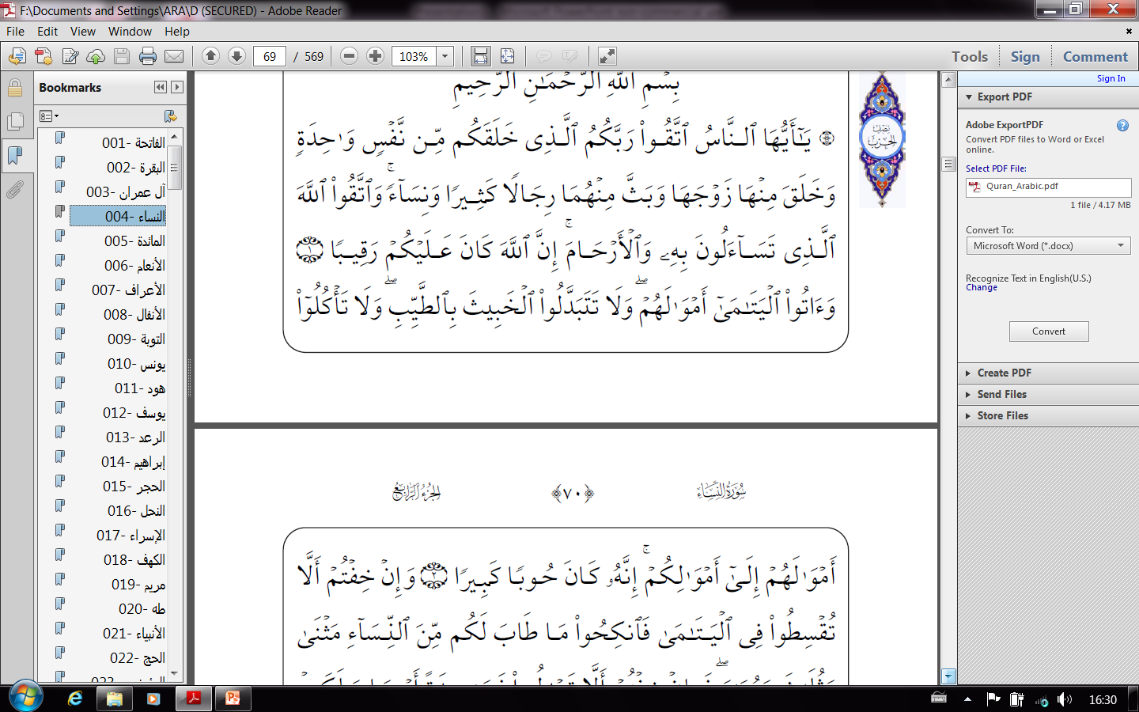
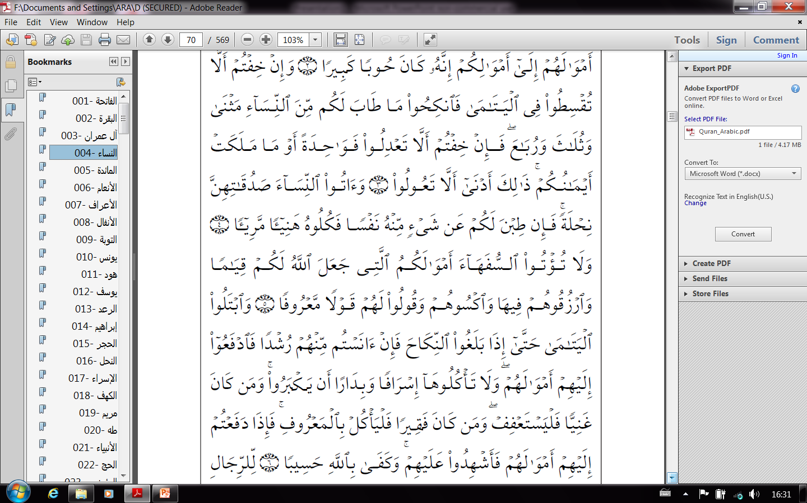
92nd Surah 4: 2 & 5-6
2C. Caution to Guardians (Wissey's)
Give the orphans their property, and do not exchange the corrupt for the good; and devour not their property with your property; surely that is a great crime. 4:2
2D. Guidelines to Guardians
But do not give to fools their property that God has assigned to you to manage;
provide for them and clothe them out of it, and speak to them honourable words. 4:5
Test well the orphans, until they reach the age of marrying; then, if you perceive in them right judgment, deliver to them their property; consume it not wastefully and hastily ere they are grown.
If any man is rich, let him be abstinent;
If poor, let him consume in reason.
And when you deliver to them their property, take witnesses over them; God suffices for a reckoner. 4:6

Slide 9
Quranic Inheritance (Irth ) Law and Will (Wasiyah )
Introduction to Islamic Inheritance (Irth ) Law and Will (Wasiyah )
Source and Chronology of Islamic Will and Inheritance Rules.
Witnessing a Wills (Wasiyah) and Guardianship Rules.
Islamic Inheritance (Irth) Distribution (Qisma) Rules.
Witness Oath, Contesting Wills and Inheritance Shares.
Reasons for Revelation of Inheritance Ayahs & Pbuh Verdicts
Islamic Inheritance Software: Test Cases & Cases, 1, 2, 3 & 4.
Summary: A. Typical “Irth” Cases B. Special “Kalala” Cases.
Conclusions: A. Chronology, B. Status of Will in Quran, C. Frequent Questions and Answers, D. Mathematics.
.

Slide 10
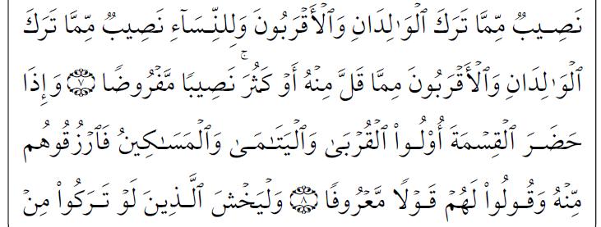
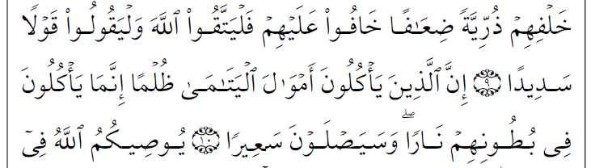
92nd Surah 4: 7-10
3A. Introduction & Guidelines to Facilitators
To the men a share of what parents and kinsmen leave, and to the women a share of what parents and kinsmen leave, whether it be little or much, a share apportioned. 4:7
And when the division is attended by kinsmen and orphans and the poor, make provision for them out of it, and speak to them honourable words. 4:8
And let those fear who, if they left behind them weak seed, would be afraid on their
account, and let them fear God, and speak words hitting the mark. 4:9
Those who devour the property of orphans unjustly, devour Fire in their bellies, and shall assuredly roast in a Blaze. 4:10
4:8 Unspecified Provision (Sadaqat) for the Deceased Kinsmen, Orphans and the Poor.

Slide 11
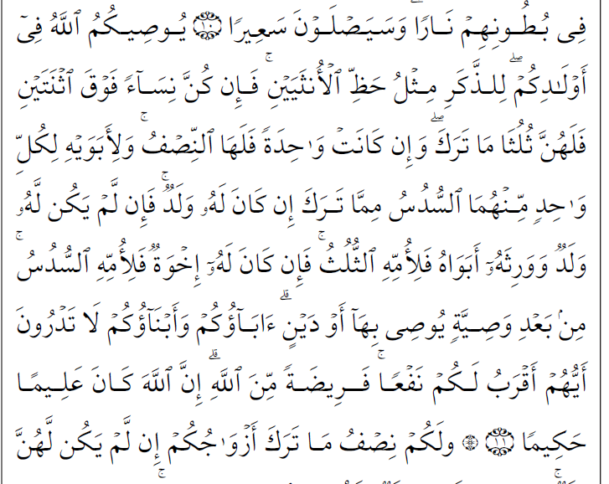






92nd Surah 4: 11
3B. Basic and Compound Children, Parents and Siblings Shares of a Dead Muslim Inheritance
God charges you, concerning your children: to the male the like of the portion of two females,
and if they be women above two, then for them two-thirds of what he leaves,
but if she be one then to her a half; and to his parents to each one of the two the sixth of what he leaves, if he has children;
but if he has no children, and his heirs are his parents, a third to his mother,
or, if he has brothers, to his mother a sixth, after any bequest he may bequeath, or any debt. Your fathers and your sons -- you know not which out of them is nearer in profit to you. So God apportions; surely God is All-knowing, All-wise. 4:11
INHERITANCE = Original Estate – (Debts + Bequests)
Ejmaa'
Shares: ((1/6_{M})+(3.33/6_{B})+(1.67/6_{S}))=6/6
Mother (1/6)
Father (2/6)
Moth 2/6
Fath. 4/6
Moth (1/6)
Fath. (1/6)
Moth (1/6)
Fath.(1/6)
Mother (1/6)
Father (1/6)
Mother (Widow) (1/6)
Ejmaa'
Man
Ejmaa'
Man
Ejmaa'
Man
Ejmaa'
Man
Brother
3.33/6
Man
Sister 1.67/6
1/6 Residue
Son
4/6
Dau.
2/6
2 Dau.
(4/6)
Dau.
(3/6)
Ejmaa'
2.67/6
1.33/6
No Offspring

Slide 12
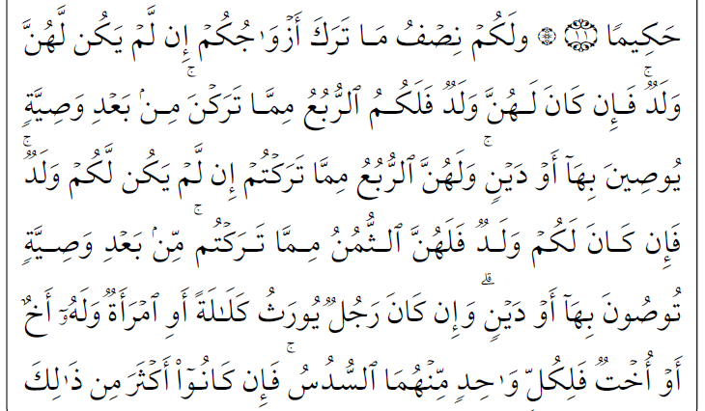
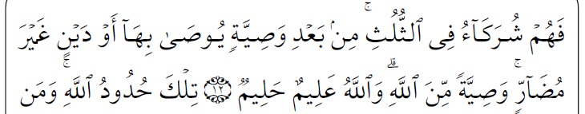
92nd Surah 4: 12
3C. Basic and Compound Spouses, Children and Parents Inheritance Shares
And for you a half of what your wives leave, if they have no children;
but if they have children, then for you of what they leave a fourth, after any bequest they may bequeath, or any debt.
And for them a fourth of what you leave, if you have no children;
but if you have children, then for them of what you leave an eighth, after any bequest you may bequeath, or any debt.
INHERITANCE =Estate-(Debts + Bequests)
Ejmaa'
INHERITANCE =Estate-(Debts + Bequests)
Mother(1/6)
Father
(2/6)
Mother (1/6)
Father (1/6)
Mother(1.5/6)
Father
(3/6)
Mother (1/6)
Father (1/6)
Woman
Husb. (3/6)
Woman
Husb. (1.5/6)
Man
Wife 1.5/6
Man
Wife 0.75/6
Ejmaa'
Son
3.5/6
Dau.
1.75/6
Son 1.67/6
Dau.
1.5/6
Ejmaa'
Son 2.17/6
Dau. 1.08/6
Son
3/6
Dau. 0.83/6
Ejmaa'
Ejmaa‘

Slide 13

92nd Surah 4: 12
3D. 1st Basic “Kalala”*(Men & Women) Ayah: Spouse(s) and Siblings Inheritance Shares
-------------------------------------------------------------------------------------------------------------------------------------------------------------------------------------------------------------------------------------------------------------------------------------------------------------------------------------------------------------------------------------------------------------------------------------------------------------------------------------------------------------------------------------------------------------------------------------------------------------------------------------------------------------------------------------------------------------------------------------------------------------------------------------------------------------------------------------------------------------------------------------------------------------------------------------------------------------------------------------------------------------------------------------------------------------------------------------------------------------------------------------------------------------------------------------------------------------------------------------------------------------------------------------------------------------------
* Deceased Person with no living parents nor living children
If a man or a woman have no heir direct, but have a brother or a sister, to each of the two a sixth;
but if they are more numerous than that, they share equally a third,
after any bequest may be bequeathed, or any debt not prejudicial; a charge from God. God is All-knowing, All-clement. 4:12*
INHERITANCE = Estate-(Debts + Bequests)
Sister
1/6
Brother
1/6
Residue: (2.5/6)
Brothers & Sisters
2/6
Residue: (2.5/6)
Man
Wife 1.5/6
Man
Wife 1.5/6
Sister
1/6
Brother
1/6
Residue: (1/6)
Brothers & Sisters
2/6
Residue: (1/6)
Woman
Husb. 3/6
Woman
Husb. 3/6
*Regarding the Residues, there are two opinions: A. Residues goes to other relatives or Beit El Maal to fulfil Ayah 4:8?, and B. Ayah 4:176 partially abrogated (superseded) Ayah 4:12 for Men by.

Slide 14
92nd Surah 4: 176
3E. 2nd (Partly Abrogated) “Kalala” (Men) Ayah: Wives and Siblings Inheritance Shares
They will ask thee for a pronouncement. Say: 'God pronounces to you concerning the
indirect heirs.
If a man perishes having no children, but he has a sister, she shall receive a half of what he leaves, and he is her heir if she has no children.
If there be two sisters, they shall receive two-thirds of what he leaves;
if there be brothers and sisters, the male shall receive the portion of two females.
God makes clear to you, lest you go astray; God has knowledge of everything. 4:176
P/Trust
2.5/6_{R}
2 Broths.
3/6
1/6 .
3/6
2 Sister
1.5/6
1/6
1.5/6
Man
Wife
1.5/6
1.5/6
1.5/6
Abrogated
4/4 Imams
Ejmaa‘
P/Trust
1.5_{R}/6 3.5/6_{R}
P/Trust
0.5_{R}/6 2.5/6_{R}
Sister
3/6
1/6
4.5/6
Man
Wife
1.5/6
1.5/6
1.5/6
Man
Wife 1.5/6
1.5/6
1.5/6
4:176 Supersedes 4:12 For Men
3/6: Shares @ Ayah 4:176 1/6: Shares @ Ayah 4:12
4.5/6: Shares @ Mawarit2
R & R =Residuals: added to blood relatives shares, or to Public Purse
2 Sisters
4/6
2/6
4.5/6
Brother
6/6
2/4 Im No Ejmaa'
2/4 Im No Ejmaa'
Woman
Sister(s) Share(s): Malki & Shafii: 3/6 & 4/6 vs Abu Haneefa & Ibn Hanbal: 4.5/6

Slide 15
92nd Surah 4: 12
3F. Revised (Abrogated) 1st “Kalala Ayah”: Husband and Siblings Inheritance Shares of “Kalala” Woman’s Estate
-------------------------------------------------------------------------------------------------------------------------------------------------------------------------------------------------------------------------------------------------------------------------------------------------------------------------------------------------------------------------------------------------------------------------------------------------------------------------------------------------------------------------------------------------------------------------------------------------------------------------------------------------------------------------------------------------------------------------------------------------------------------------------------------------------------------------------------------------------------------------------------------------------------------------------------------------------------------------------------------------------------------------------------------------------------------------------------------------------------------------------------------------------------------------------------------------------------------------------------------------------------------------------------------------------------------
* Deceased Person with no living parents nor living children
If a man or a woman have no heir direct, but have a brother or a sister, to each of the two a sixth;
but if they are more numerous than that, they share equally a third, after any bequest may be bequeathed, or any debt not prejudicial; a charge from God. God is All-knowing, All-clement.4:12*
Brother
6/6
Ejmaa'
4:176
Woman
Ejmaa'
INHERITANCE = Estate-(Debts + Bequests)
Shares: ((1/6+1/6_{R}) +(1/6)+(3/6))=6/6
Shares: (1/6) + (1/6+1/6_{R})+(3/6))= 6/6
Brother
1/6
+(1/6_{R})
Sister
1/6
Residue: (1/6)
2Sis (1/6) & 2Bro (1/6) + (1/6_{R})=(3/6)
Residue: (1/6)
Woman
Husband
3/6
Woman
Husband
3/6
Ejmaa'
Ejmaa'
After partial abrogation by Ayah 4:167, Ayah 4:12 is therefore applies only on Deceased Kalala Women, the 1/6 Residue will be added to Brother(s) Shares. This is without overlooking provisions to Poor @ Ayah 4:8? (And Allah Omniscient).

Slide 16
Quranic Inheritance (Irth ) Law and Will (Wasiyah )
Introduction to Islamic Inheritance (Irth ) Law and Will (Wasiyah )
Source and Chronology of Islamic Will and Inheritance Rules.
Witnessing a Wills (Wasiyah) and Guardianship Rules.
Islamic Inheritance (Irth) Distribution (Qisma) Rules.
Witness Oath, Contesting Wills and Inheritance Shares.
Reasons for Revelation of Inheritance Ayahs & Pbuh Verdicts
Islamic Inheritance Software: Test Cases & Cases, 1, 2, 3 & 4.
Summary: A. Typical “Irth” Cases B. Special “Kalala” Cases.
Conclusions: A. Chronology, B. Status of Will to in Quran, C. Frequent Questions and Answers, D. Mathematics.
.
.

Slide 17
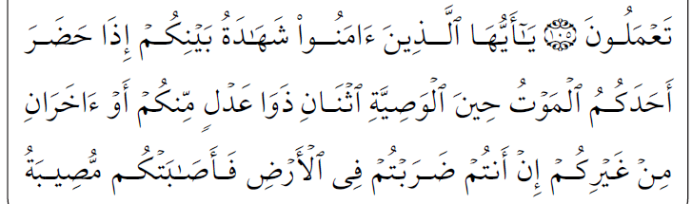
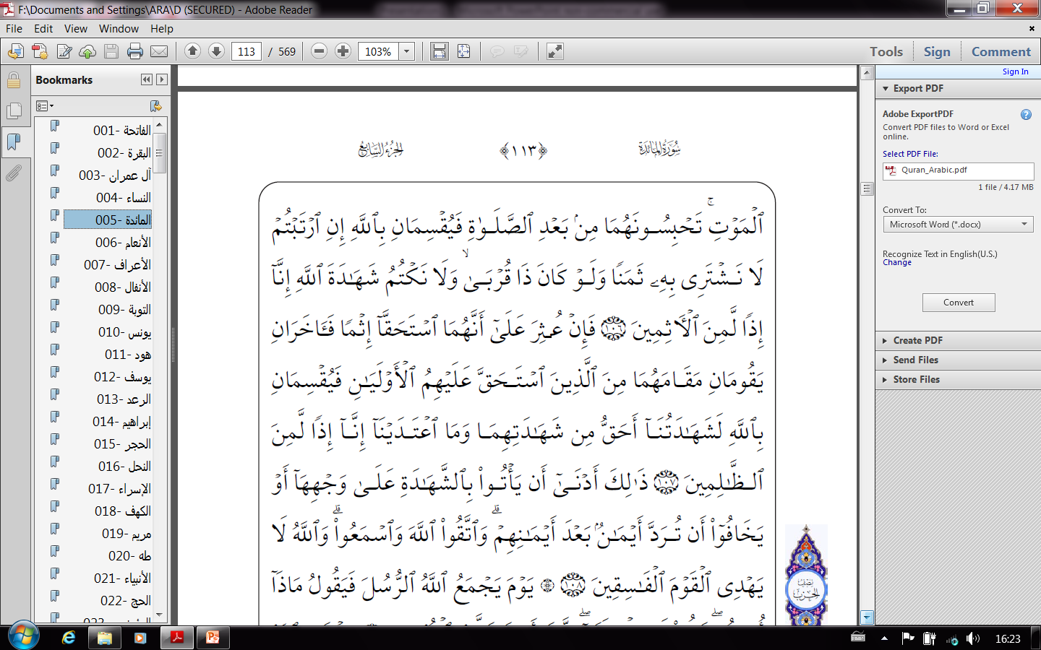
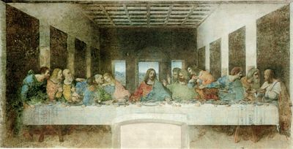
112th Surah 5: 106
4A. Procedure of Verbal Will Witnessing
O believers, the testimony between you when any of you is visited by death, at the bequeathing, shall be two men of equity among you; or two others from another folk, if you are journeying in the land and the affliction of death befalls you.
Them you shall detain after the prayer, and they shall swear by God, if you are doubtful, 'We will not sell it for a price, even though it were a near kinsman, nor will we hide the testimony of God, for then we would surely be among the sinful‘ 5:106
Jesus (Pbuh) and 12 Disciples
And when the Apostles said, 'O Jesus son of Mary, is thy Lord able to send down on us a
Table out of heaven?' He said, 'Fear you God, if you are believers. (The Table) 5:112

Slide 18
112th Surah 5: 107-108
4B. Contesting Wills or Witness Testaments
But if it be discovered that both of them have merited the accusation of any sin, then two others shall stand in their place, these being the nearest of those most concerned, and they shall swear by God, 'Our testimony is truer than their testimony, and we have not transgressed, for then we would assuredly be among the evildoers’. 5:107
So it is likelier that they will bear testimony in proper form, or else they will be afraid that after their oaths, oaths may be rebutted. Fear God, and hearken; God guides not the people of the ungodly. 5:108

Slide 19
Quranic Inheritance (Irth ) Law and Will (Wasiyah )
Introduction to Islamic Inheritance (Irth ) Law and Will (Wasiyah )
Source and Chronology of Islamic Will and Inheritance Rules.
Witnessing a Wills (Wasiyah) and Guardianship Rules.
Islamic Inheritance (Irth) Divisions (Qisma) Rules.
Witness Oath, Contesting Wills and Inheritance Shares.
Reasons for Revelation of Inheritance Ayahs & Pbuh Verdicts
Islamic Inheritance Software: Test Cases & Cases, 1,icts 2, 3 & 4.
Summary: A. Typical “Irth” Cases B. Special “Kalala” Cases.
Conclusions: A. Chronology, B. Status of Will in Quran, C. Frequent Questions and Answers D. Mathematics.
.
.

Slide 20
5A. Reasons for Revelation of 4:11-12 (Inheritance) Ayahs *
The wife of Sa’d Ben Al-Rabeá came to the Prophet (Pbuh) with her two daughters, and said: “These are the daughters of Sa’d who died a martyr beside you at Uhud, their uncle took their money and left them with nothing, and they cannot be married without money”.
The Prophet (Pbuh) said: God will decree in this.
Shortly after that the inheritances Ayahs were revealed, and the Prophet (Pbuh) summoned their uncle and told him to: “Give the daughters two thirds, their mother the eighth and what is left is yours”.
* (After Jaber, confirmed by the five narrators except Al Nisae’y)

Slide 21
5B. Prophet’s (Pbuh) Verdict on Grandfather Inheritance
“(Abdullah Bin Mas’ud was once asked in regard to the inheritance of a daughter, granddaughter and sister of a deceased man, he decreed after the Prophet (Pbuh): “The daughter’s share is one-half, that of the son’s daughter is one-sixth, and whatever remains for the sister.”

Slide 22

5C. Prophet’s (Pbuh) Verdict on Maximum Amount of Bequest
Sa’d Bin Abi Waqqas (RAA) narrated* that he was struck by sever illness during the farewell Pilgrimage and felt he was close to death. The Prophet (Pbuh) visited him, and he said to him “O Messenger of Allah, I am reduced to this state because of illness. I have a vast wealth and no heirs except my daughter. Should I bequeath two thirds of my estate?” He (Pbuh) replied: “No.” He said: “One half of my estate then?” He (Pbuh) replied: “No.” He said: “One third of my estate then?” He (Pbuh) said: “Yes, one third; and even one third is too much.
Indeed, O Sa’d, you’d better leave your inheritors rich after you than leave them as a burden, begging people.”
Indeed, O Sa'd, you will never spend money seeking by it Allah’s Face, but you will be rewarded for it- even for the morsel of food that you put into your wife’s mouth.
And if you live after me, never would you do a good deed seeking thereby Allah’s Face, but will increase by it in position and elevation. Furthermore, you may live longer so that some people will benefit from you and others will be harmed.
O Allah, fulfil my companions’ Hijrah, and do not turn them back upon their heels. But the miserable one was Sa’d Bin Khawlah.”
__________________________________________________________________________
* (Al-Bukhari, Muslim and Others)

Slide 23
5D. Wasiyah and Inheritance Verdicts and Precedence in Hadiths
On the subject of inheritance, The Messenger of Allah (Pbuh) was narrated to have said:
1. “No bequest may be made to (standard) heir.”
“Give the ordained shares to their rightful heirs, whatever left to the nearest male (to the deceased).”
3. “Allah and His Messenger are the guardians of the one who does not have a guardian; and a maternal uncle inherits who doesn’t have any [closer] heirs.”
4. “As soon as the baby cries (at birth), it inherits.”
5. “A killer does not inherit (from his victim).”
6. “Whichever man commits Zina (adultery), the child is a child of Zina, it neither inherits nor given inheritance.”
7. “The followers of two different religions cannot inherit each others.”
8. “A Kafer (Idol-Worshipper) cannot inherit a Muslim, nor a Muslim a Kafer.”
9. “It is not permissible for any Muslim who has something to will to stay for two nights without having his will and testament written and kept ready with him.”
_______________________________________________________________________
References
1. (Several Sahabah), 2. (Ibn Abbas), 3. (Umar), 4. (Abu Hurayrah), 5. (Abu Hurayrah), 6. (Ibn Umar), 7.Usamah, Jaber, and Ibn Amer), 8. (Usamah), 9. (Abdallah bin Umar: Sahih Al-Bukhari).

Slide 24
Quranic Inheritance (Irth ) Law and Will (Wasiyah )
Introduction to Islamic Inheritance (Irth ) Law and Will (Wasiyah )
Source, Chronology of Islamic Will, and Inheritance Rules.
Witnessing a Wills (Wasiyah) and Guardianship Rules.
Islamic Inheritance (Irth) Division Rules (Qisma).
Witness Oath, Contesting Wills and Inheritance Shares.
Reasons for Revelation of Inheritance Ayahs & Pbuh Verdicts
Islamic Inheritance Software: Test Cases & Cases, 1, 2, 3 & 4.
Summary: A. Typical “Irth” Cases B. Special “Kalala” Cases.
Conclusions: A. Chronology, B. Status of Will in Quran, C. Frequent Questions and Answers, D. Mathematics.
.
.

Slide 25
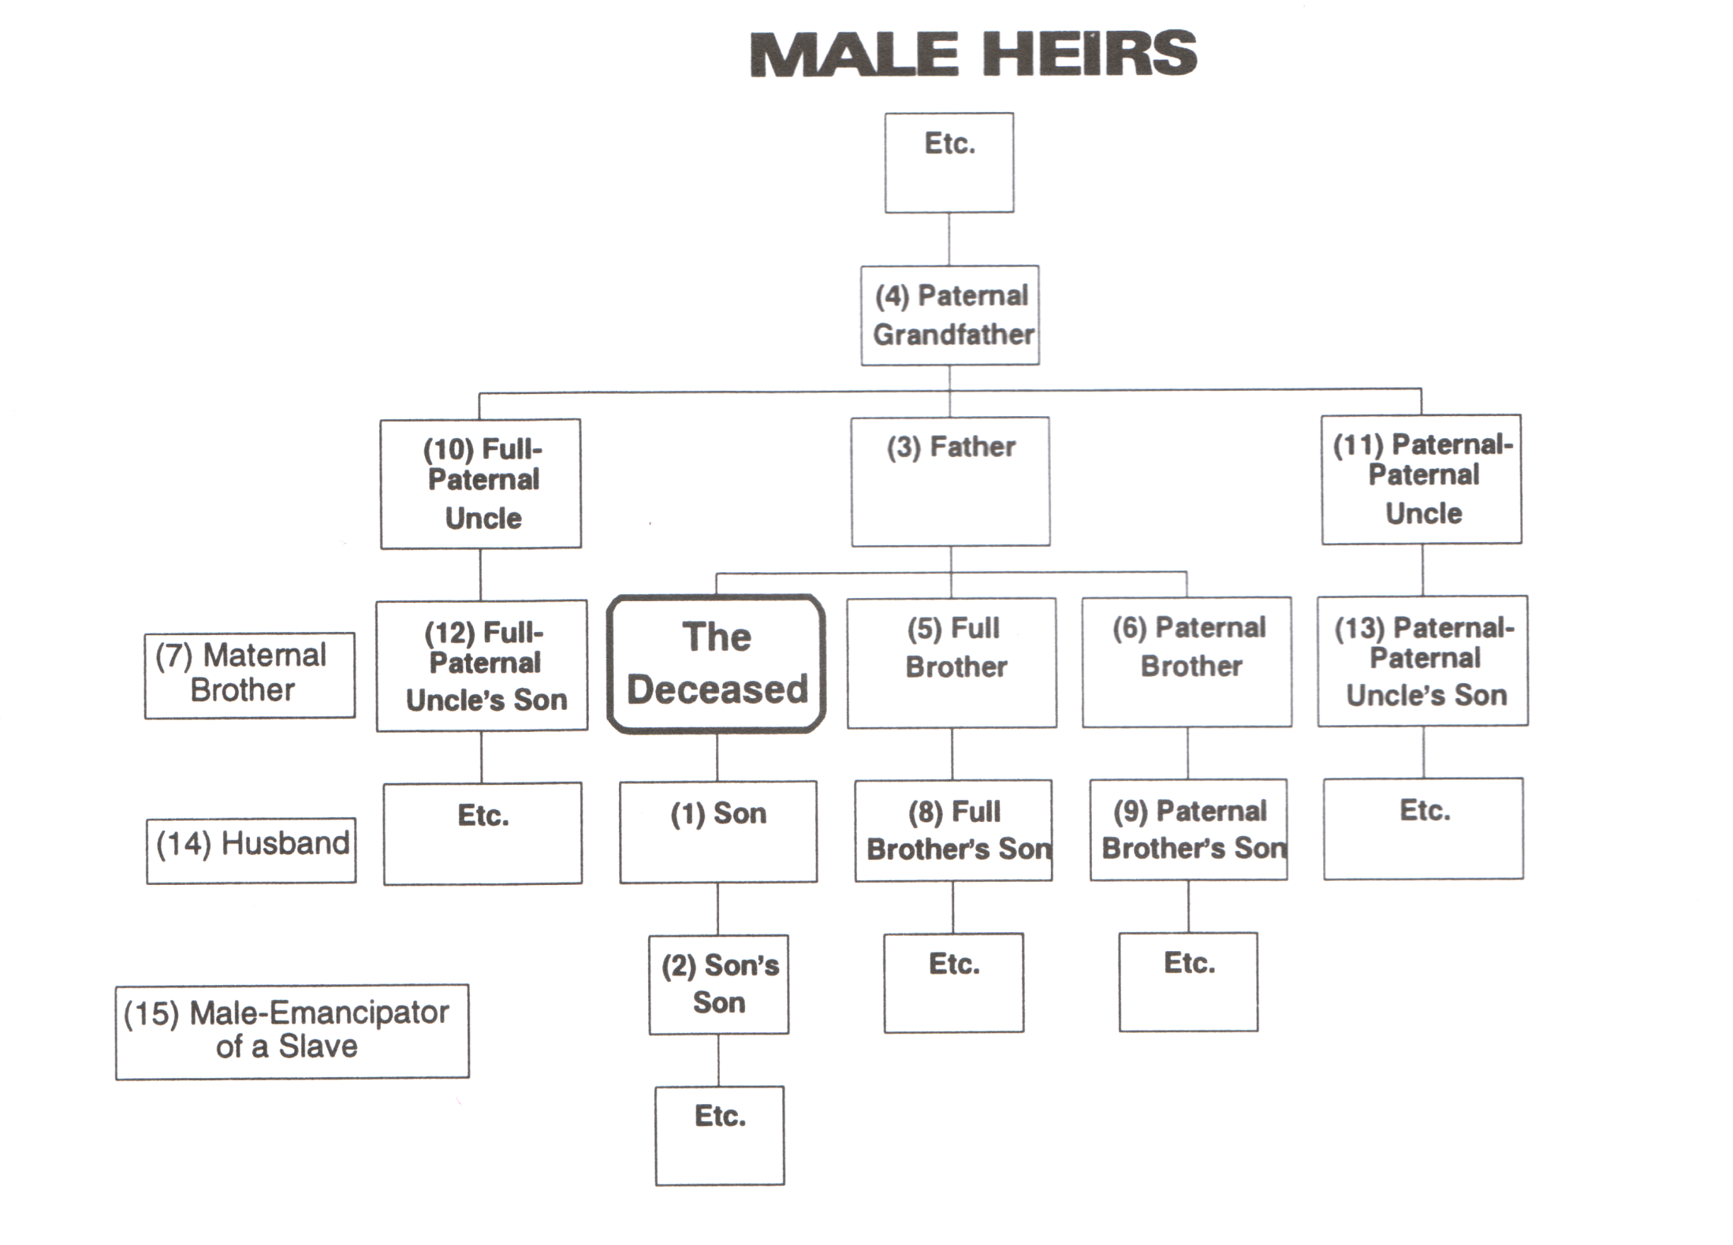
6A.
14 Candidates
Offspring edicts Husband & Parents shares
15 Candidates
(Modified after Al Jibaly, 1999)

Slide 26
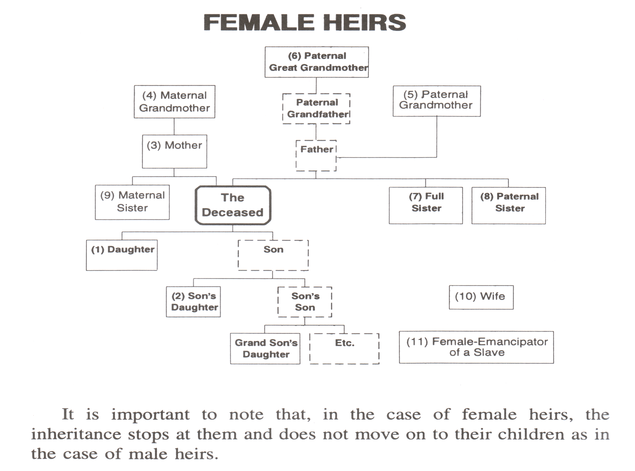


6B.
10 Candidates
Offspring edicts Wife & Parents shares
11 Candidates
(Modified after Al Jibaly, 1999)

Slide 27
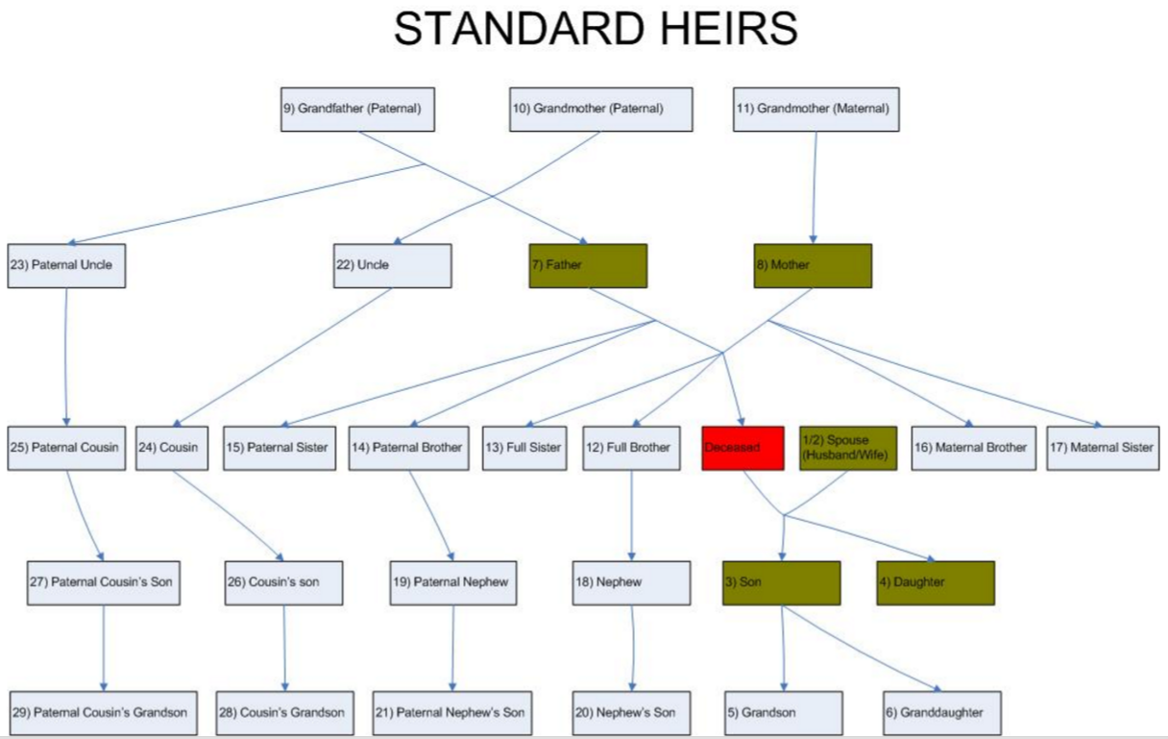
6C.
Deceased
Total 29 Male & Female Candidates
After Anon, 2016
http://inheritance.ilmsummit.org/projects/inheritance/home.aspx

Slide 28
6C. Islamic Inheritance Calculation Software
Aydemir, Halis, MIRAS: (7 Heirs Web-based Simple Programme, Failed Sunnah Test)
Link: http://www.kurandersleri.net/miras/en/Miras_en.html
Lubnaa, Inheritance Calculator: (10 Heirs Web-based Simple Programme, Failed Test) Link: http://www.lubnaa.com/money/InheritCalc.php
Anon, Al-Merath: (29 Heirs Web-based Programme, Passed Most Test Cases)
Links: http://inheritance.ilmsummit.org/projects/inheritance/home.aspx
http://inheritance.ilmsummit.org/projects/inheritance/testcasespage.aspx
http://inheritance.ilmsummit.org/projects/inheritance/faq.aspx
http://inheritance.ilmsummit.org/projects/inheritance/rules.aspx
http://inheritance.ilmsummit.org/projects/inheritance/articles.aspx
Muhieddine, Ahmad, 2001, Mawarit2, (19 Heirs Prog., Passed Most Ejmaa', Test Cases)
Link: http://www.qsl.net/vu2sdu/download.html
Abu Mustapha, Ayman, IRTH: (25 Heirs Programme, 4 Mathaheb, Passed Test Cases) Links: http://www.islamchannel.tv/pages/InheritCalculator.aspx
http://www.islamicsoftware.org/irth/irthhelp.html
http://www.islamicsoftware.org/irth/local.html
http://www.huda.tv/services/islamic-applications/inheritance-calculator

Slide 29
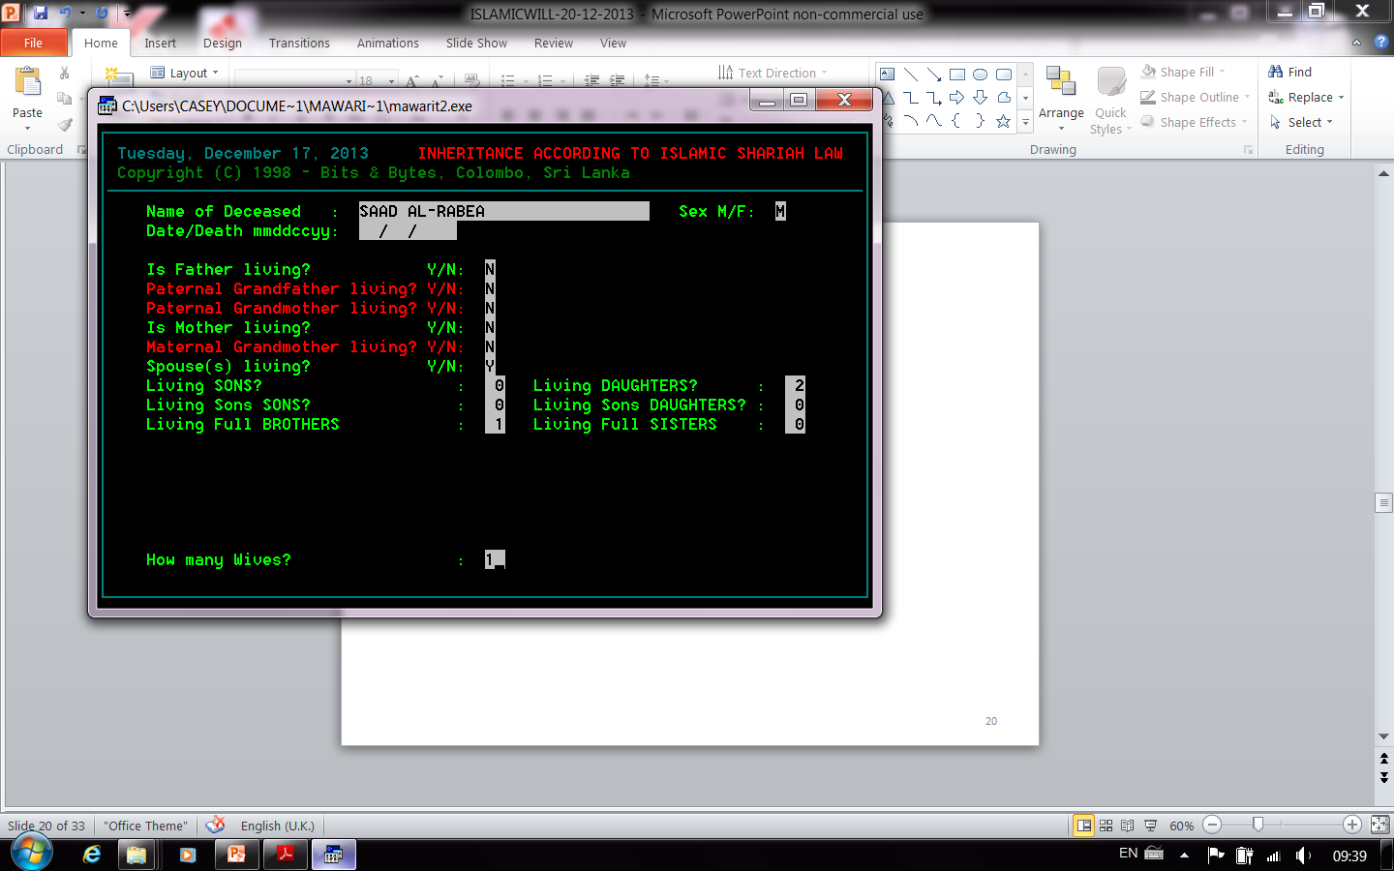
Inputs Case A: Sa’d Leaving Wife, Two Daughters & Brother
(After Muheiddine, 2001 )

Slide 30
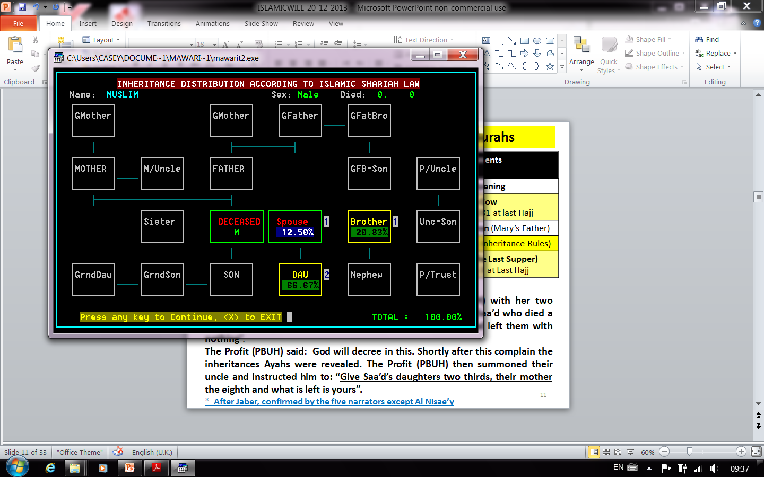
Outputs Case A: Sa’d Leaving Wife, Two Daughters & Brother

Slide 31
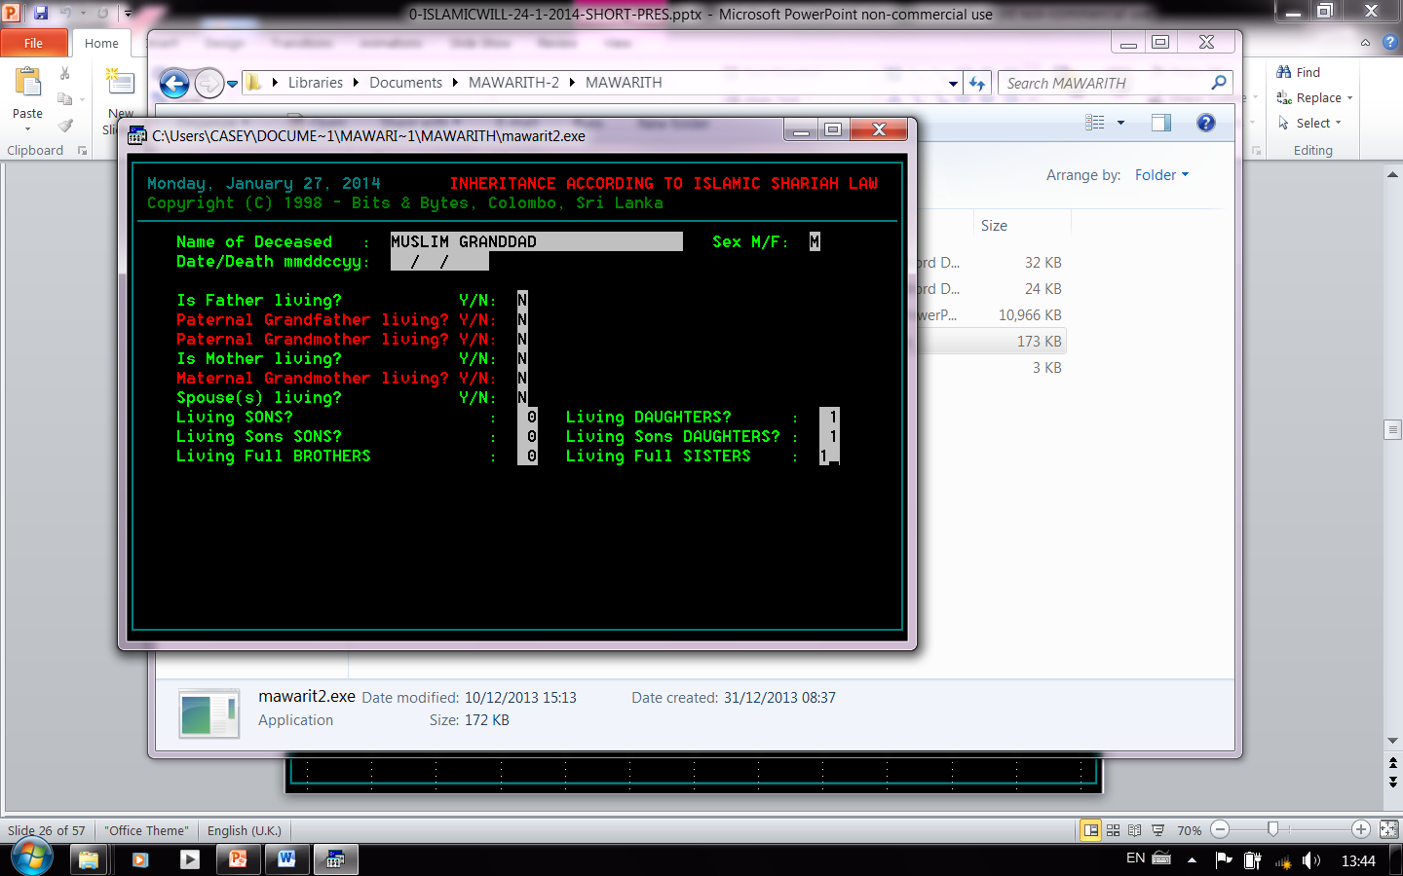
Inputs Case B: Man Leaving , Daughter, Granddaughter & Sister

Slide 32
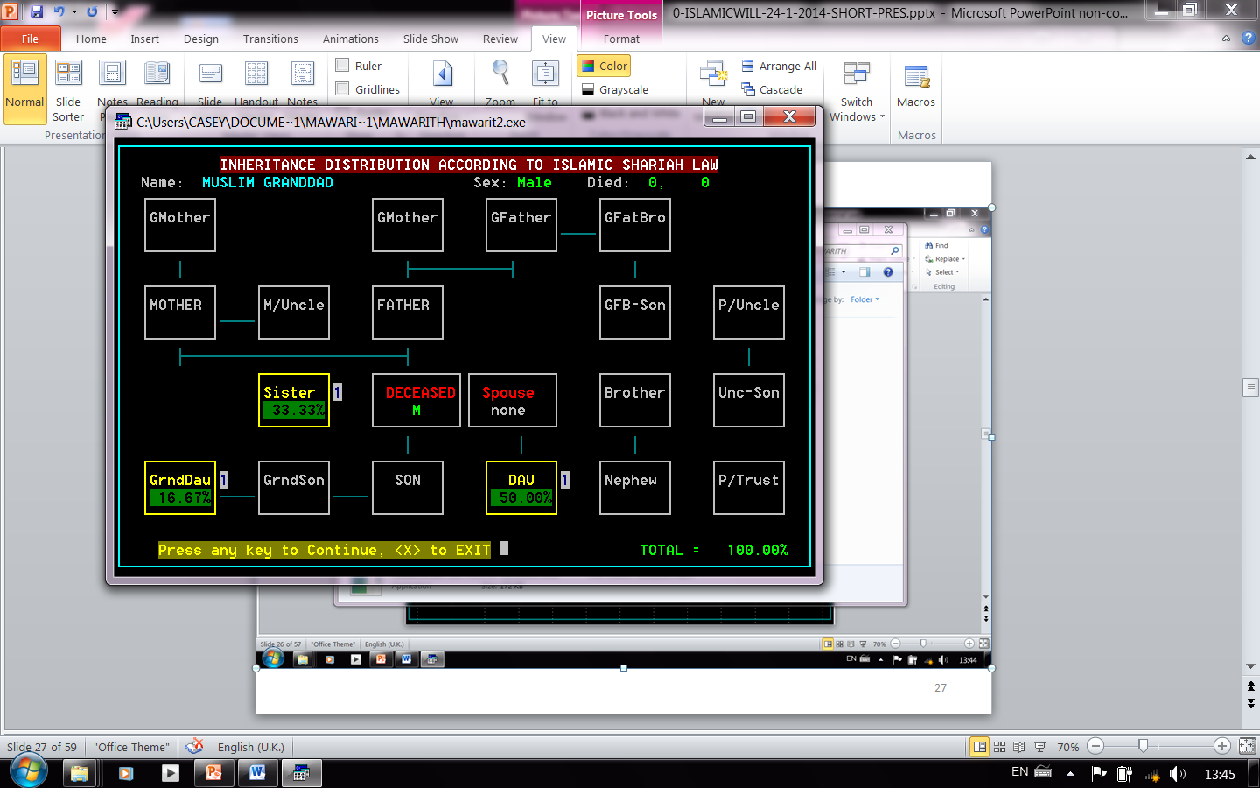
Outputs Case B: Man Leaving , Daughter, Granddaughter & Sister

Slide 33
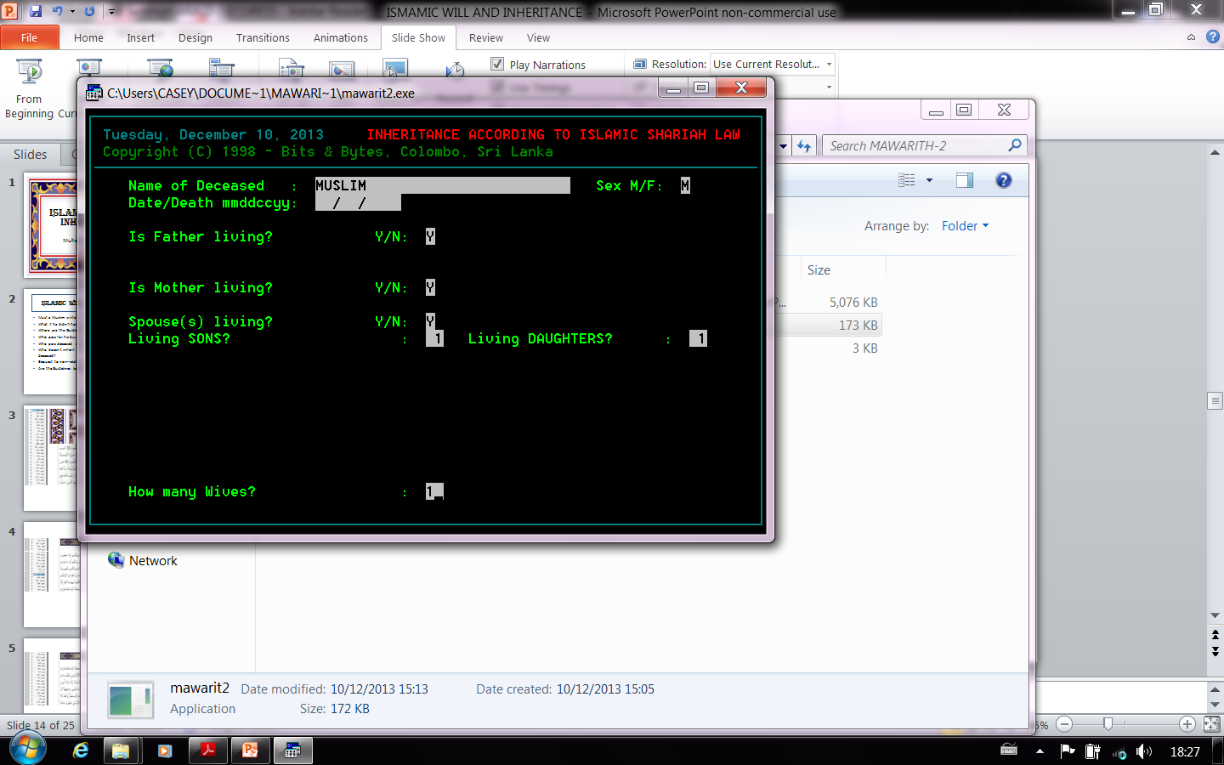
Inputs Case C: Man leaving Wife, Children & Parents

Slide 34
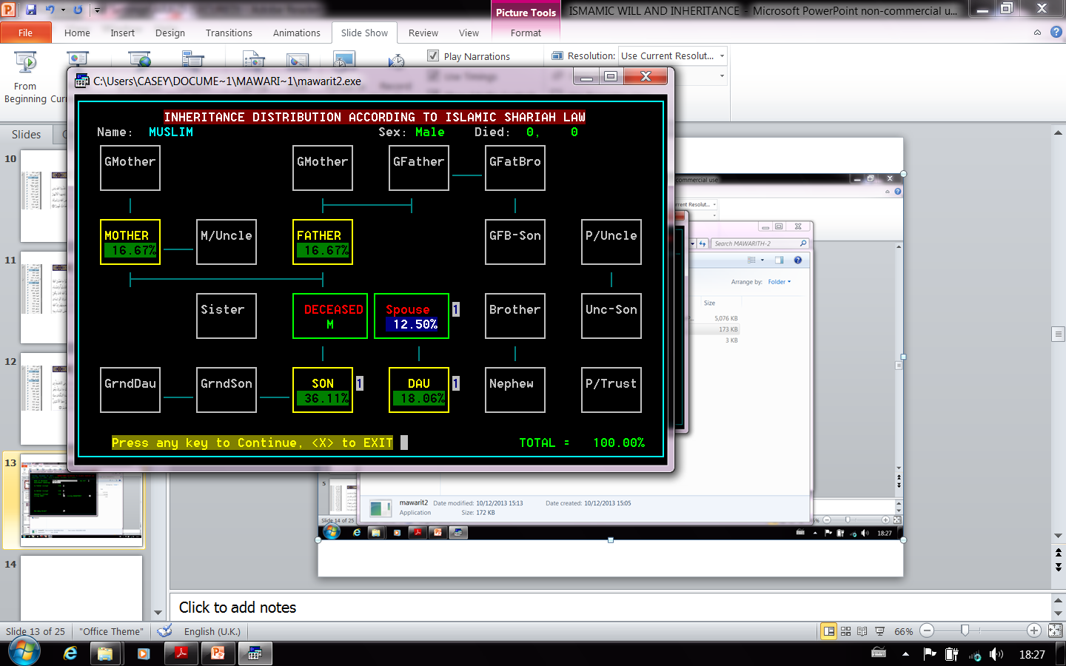
Outputs Case C: Man leaving Wife, Children & Parents

Slide 35
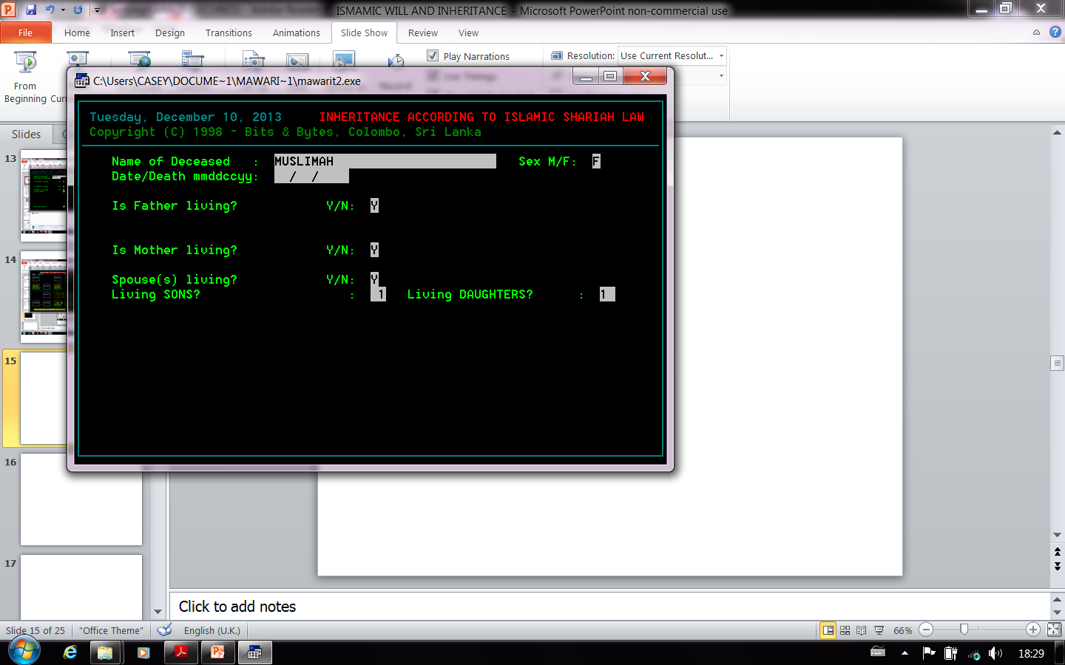
Inputs Case D: Woman leaving Husband, Children & Parents

Slide 36
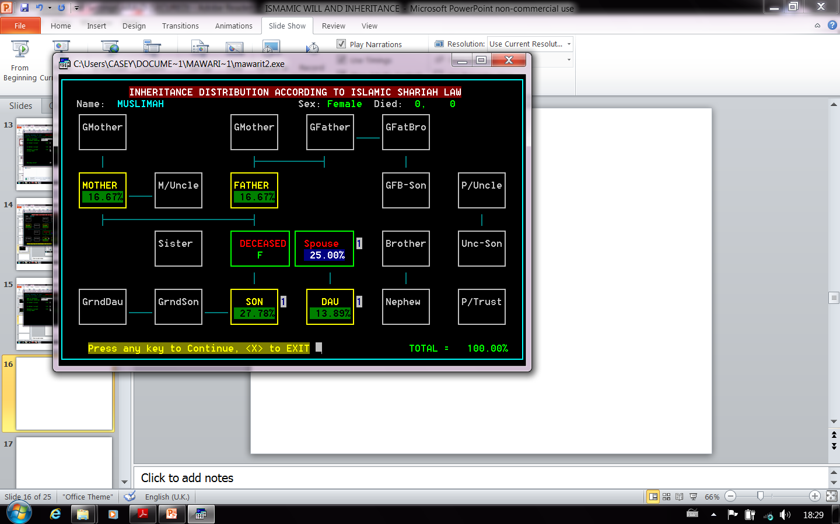
Outputs Case D: Woman leaving Husband, Children & Parents

Slide 37
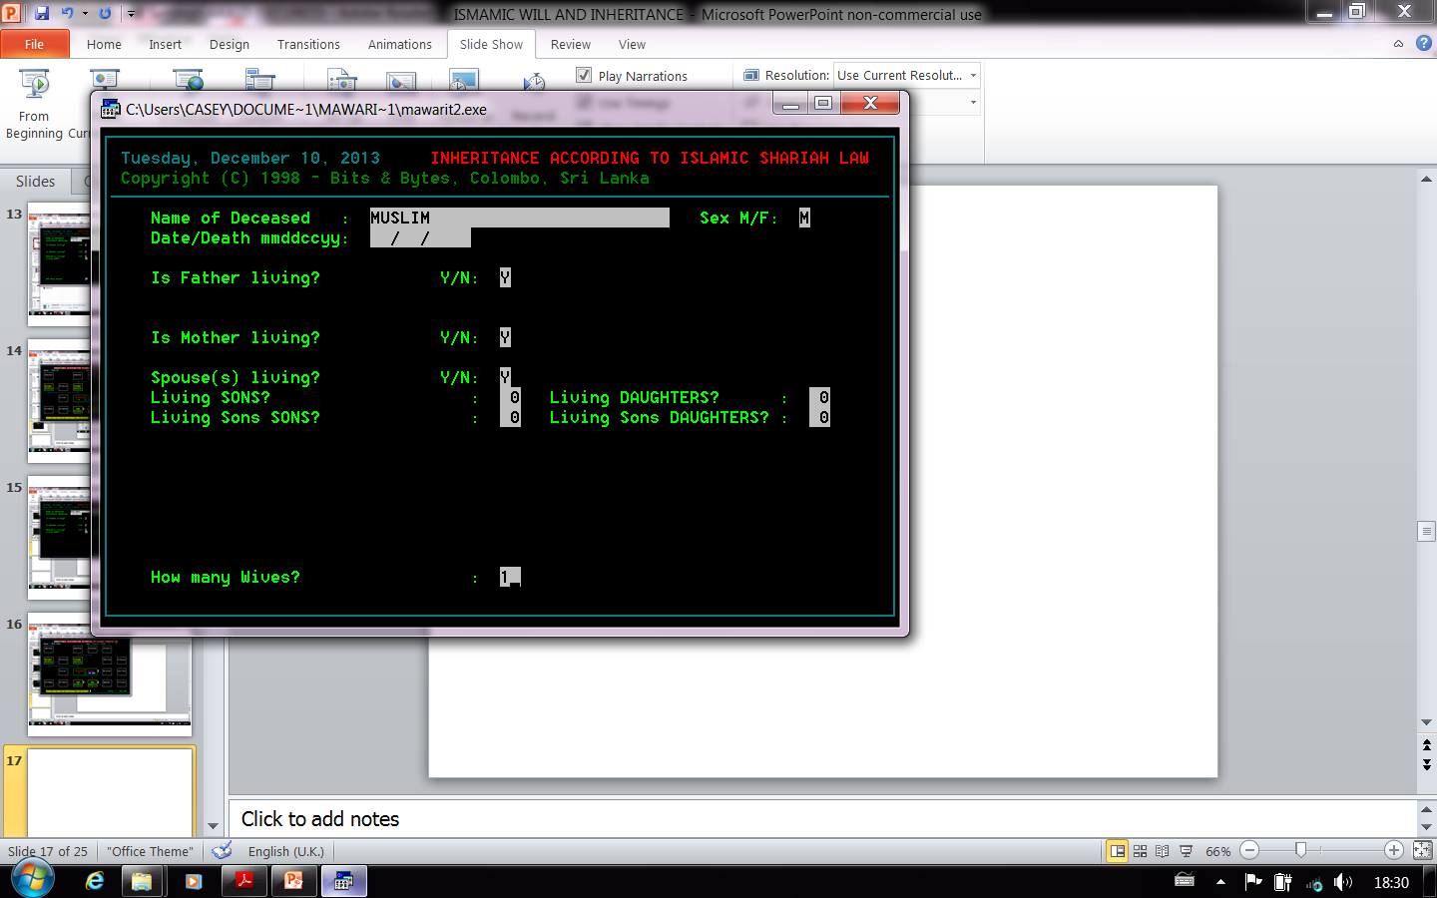
Inputs Case E: Man leaving Wife & Parents

Slide 38
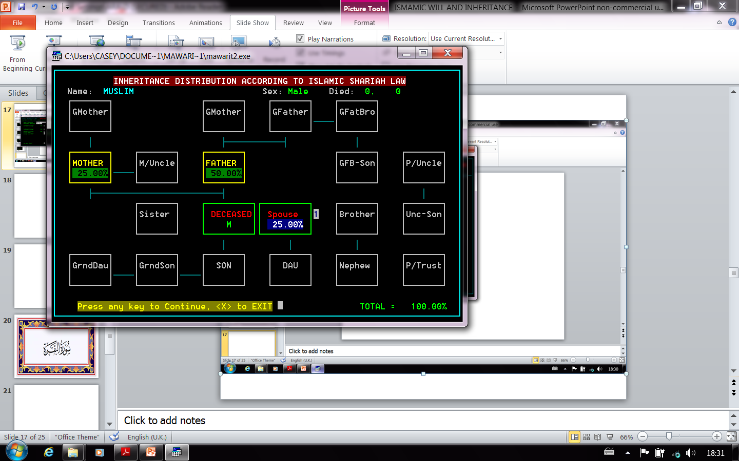
Outputs Case E: Man leaving Wife & Parents

Slide 39
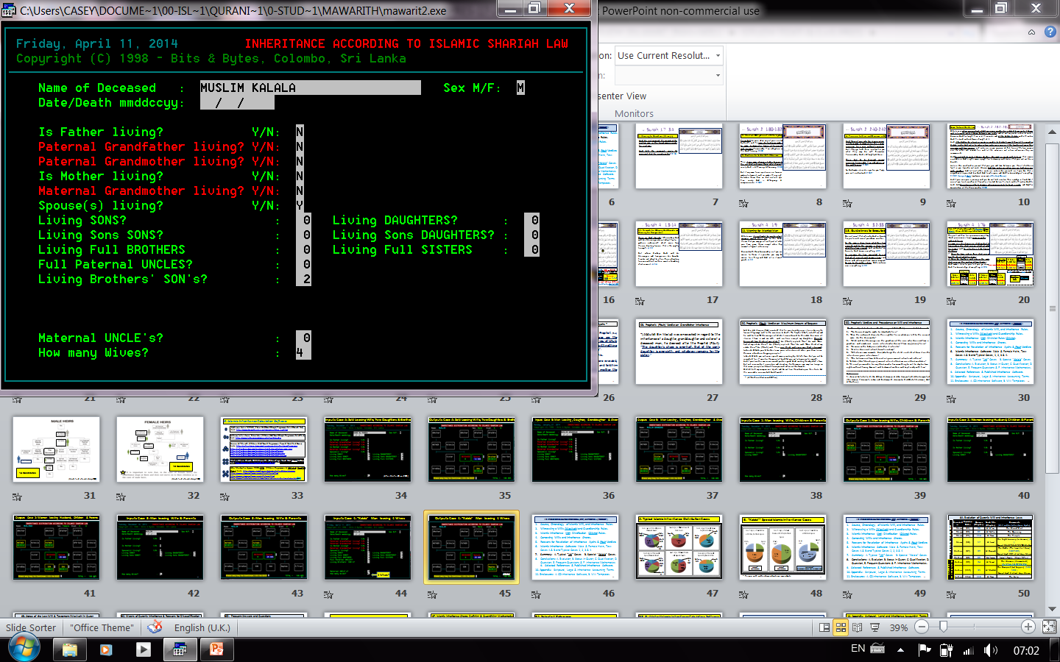
Inputs Case F: “Kalala” Man leaving 4 Wives
4 Wives?

Slide 40
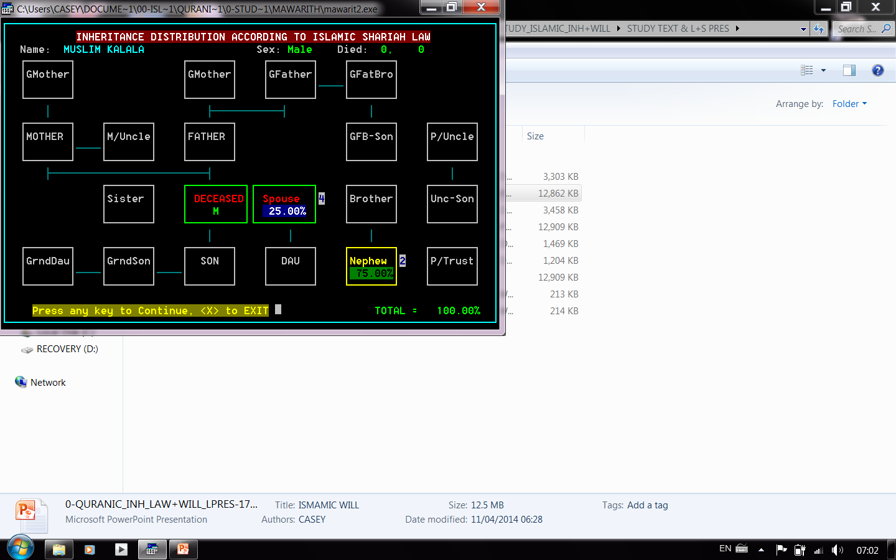
Outputs Case F: “Kalala” Man leaving 4 Wives
Ejmaa'

Slide 41
Quranic Inheritance (Irth ) Law and Will (Wasiyah )
Introduction to Islamic Inheritance (Irth ) Law and Will (Wasiyah )
Source, Chronology of Islamic Will, and Inheritance Rules.
Witnessing a Wills (Wasiyah) and Guardianship Rules.
Islamic Inheritance (Irth) Distribution (Qisma) Rules.
Witness Oath, Contesting Wills and Inheritance Shares.
Reasons for Revelation of Inheritance Ayahs & Pbuh Verdicts
Islamic Inheritance Software: Test Cases & Cases, 1, 2, 3 & 4.
Summary: A. Typical “Irth” Cases B. Special “Kalala” Cases.
Conclusions: A. Chronology, B. Status of Will in Quran, C. Frequent Questions and Answers, D. Mathematics.
.

Slide 42
7A. Typical Islamic Inheritance Distribution (Ejmaa') Cases

Slide 43
7B. “Kalala”* Special Islamic Inheritance Cases
PT %, (25)
Sister %, (50)
Ejmaa'
4/4 Imams
Ejmaa'
4/4 Imams
No Ejmaa'
2 Imams (50%) vs. 2 Imams (75%)
* Person with neither descendants nor ascendants
Sister Share: Malki & Shafii: 3/6 vs. Abu Haneefa & Ibn Hanbal:4.5/6

Slide 44
Quranic Inheritance (Irth ) Law and Will (Wasiyah )
Introduction to Islamic Inheritance (Irth ) Law and Will (Wasiyah )
Source, Chronology of Islamic Will, and Inheritance Rules.
Witnessing a Wills (Wasiyah) and Guardianship Rules.
Islamic Inheritance (Irth) Distribution (Qisma) Rules.
Witness Oath, Contesting Wills and Inheritance Shares.
Reasons for Revelation of Inheritance Ayahs & Pbuh Verdicts
Islamic Inheritance Software: Test Cases & Cases, 1, 2, 3 & 4.
Summary: A. Typical “Irth” Cases B. Special “Kalala” Cases.
Conclusions: A. Evolution of “Irth” Laws, B. Status in Quran, C. Frequent Questions and Answers, D. Mathematics.

Slide 45
8A. Evolution of Quranic Will and Inheritance Laws
Revealed in | Revelation Order | Quranic (Chapter) | Surah Title (Chapter) | Comments (Will and/or Inheritance Ayahs)
Mecca | (01) | 96 | Al A’laq | The Blood-Clot
Mecca | (05) | 01 | Al Fatiha | The Opening
Mecca | (21) | 114 | Al Naas | The People
Mecca | (50) | 17 | Al Israa’ | The Night Journey (to Heaven) (34) Except 26,32-33,57,73-80, Medina
Medina | (87) | 02 | Al Baqarah | The Cattle (The Israelites' Cow) (180-182) Except Ayah 281 at last Hajj, Mecca
Medina | (89) | 03 | Aal Imran | Imran’s Family (Mary’s Father)
Medina | (92) | 04 | Al Nisaa’ | The Women (Womankind) (2, 5-14, 19, 32-33, 176)
Medina | (112) | 05 | Al Maídah | The Banquet (Last Supper) (106-108) Except Ayah 3 at Last Hajj, Mecca
Medina | (114) | 110 | Al Nasr | The Help
Will Decides Heirs & Shares
Heirs & Shares are Prescribed

Slide 46
8B. Status of Wasiyah (Last Will & Testament) in Quran
Justice, Zakat, Conduct and Manners: Surely God bids to justice, charity and giving to kinsmen; and He forbids indecency, dishonour and insolence, admonishing you, so that haply you will remember. 16:90
1. Justice: O believers, prescribed for you is retaliation, touching the slain; freeman for freeman, slave for slave, female for female. But if aught is pardoned a man by his brother, let the pursuing be honourable, and let the payment be with kindliness.2:178
2. The Last Will & Testament: Prescribed for you, when any of you is visited by death, and he leaves behind some goods, is to make testament in favour of his parents and kinsmen honourably -- an obligation on the godfearing. 2:180
3. Fasting: O believers, prescribed for you is the Fast, even as it was prescribed for those that were before you -- haply you will be godfearing – 2:183
4. Jihad: Prescribed for you is fighting, though it be hateful to you. Yet it may happen that you will hate a thing which is better for you; and it may happen that you will love a thing which is worse for you; God knows, and you know not. 2:216
5. Pilgrimage: It is the duty of all men towards God to come to the House a pilgrim, if he is able to make his way there. 3:97
6. Prayers: When you have performed the prayer, remember God, standing and sitting and on your sides. Then, when you are secure, perform the prayer; surely the prayer is a timed prescription for the believers. 4:103

Slide 47
There are 4 means of inheritance:
Inheritance by lineage, by marriage, by a slave obtaining freedom, and by a public body or establishment such as BaitulMal , Awqaf or the Treasury.
There are 7 reasons for inheritance disqualification:
Inheritor responsible or having any connection with the death of the person whose heir he/she is, becoming Kafer, on other faith, illegitimacy, being missing and presumed dead, becoming a slave, and uncertainty as to who died first?
Questions & Answers
Must a Muslim have a Will?
Deceased have heirs but no Will?
Who pays for the burial cost?
Who pays deceased debts?
Can a Will include bequests?
If there is no Heir & no Will?
Why there are share Residues?
Can an adopted child Inherits?
How applicable are Islamic Inheritance Laws nowadays?
It is an obligation for Adult Muslim.
Estate divided acc. to Surah 4.
Normally off deceased estate.
Typically off deceased estate.
Up to 1/3 of Estate to Non-heritor.
Estate handed over to P/Trust.
To be a posthumous Sadaqah 4:8.
No, but can be given a bequest.
The Laws are logical, thorough systematic & programmable.

Slide 48
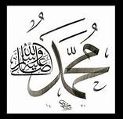
8C. Why the Divinely Prescribed Inheritance Shares of the Quran aren’t Apportioned in Percentages?
1/8 , 1/6, 1/4 , 1/3, 1/2, 2/3, 1/1
Prophet Muhammad (Pbuh) (Mecca & Medina, 571-632 AD. (Al Nisaa’/Uhud 3 AH. = 625 AD.)
Brahma-Gupta in 650 AD. (India) Discovered the Zero “Kha”.
Jaber Bin Hayyan (721-815 AD. Baghdad) Discovered Algebra.
Khwarizmi (780-850 AD. Baghdad) introduced Zero to Sciences.
12.5%, 16.67%, 0.25, 0.33

Slide 49
8D. Islamic Inheritance Shares Defining & Quantifying Mathematics
The Quran | Scholars | This Study | Digital | Digital
7 HEIRE PORTIONS | ALGEBRAIC COMMON DENOMINATOR OF 24 | DECIMAL NUMERATOR/COMMON DENOMINATOR OF 0./6 | DECIMALS 0. | PERCENTAGE %
1/8 | 3/24 | 0.75/6 | 0.125 | 12.50
1/6 | 4/24 | 1/6 | 0.166 | 16.67
1/4 | 6/24 | 1.5/6 | 0.250 | 25.00
1/3 | 8/24 | 2/6 | 0.333 | 33.33
1/2 | 12/24 | 3/6 | 0.500 | 50.00
2/3 | 16/24 | 4/6 | 0.666 | 66.67
(3/4)* | 18/24 | 4.5/6 | 0.750 | 75.00
1/1 | 24/24 | 6/6 | 1.000 | 100.00
* No Ejmaa'

Slide 50
Thank You.
Questions?
Selected References
Abdal-Haqq, H. et.al., 1995, The Islamic Will, Dar Al Taqwa, London, UK, 72P.
Hussain, Abed, ?, Islamic Laws of Inheritance, 5P.
Link: http://www.islam101.com/sociology/inheritance.htm
Al-Jibaly, Muhammad, 1999, The Final Bequest: The Islamic Will & Testament. Al-Kitaab & As-Sunnah Publishing, Arlington, Texas, USA. 122p.
Arberry, Arthur, 1955, The Quran Interpreted, Oxford Univ. Press., Oxford, UK.
Link: https://ia601706.us.archive.org/20/items/QuranAJArberry/Quran-A%20J%20Arberry.pdf
Islamic Bulletin, ?, Islamic Last Will and Testament Template, ,USA. 5P
Link: http://islamicbulletin.org/free_downloads/last_will.pdf
Muhieddine, Ahmad, 2001, Mawarit2, Computer Programme.
Link: http://www.qsl.net/vu2sdu/download.html

Slide 51
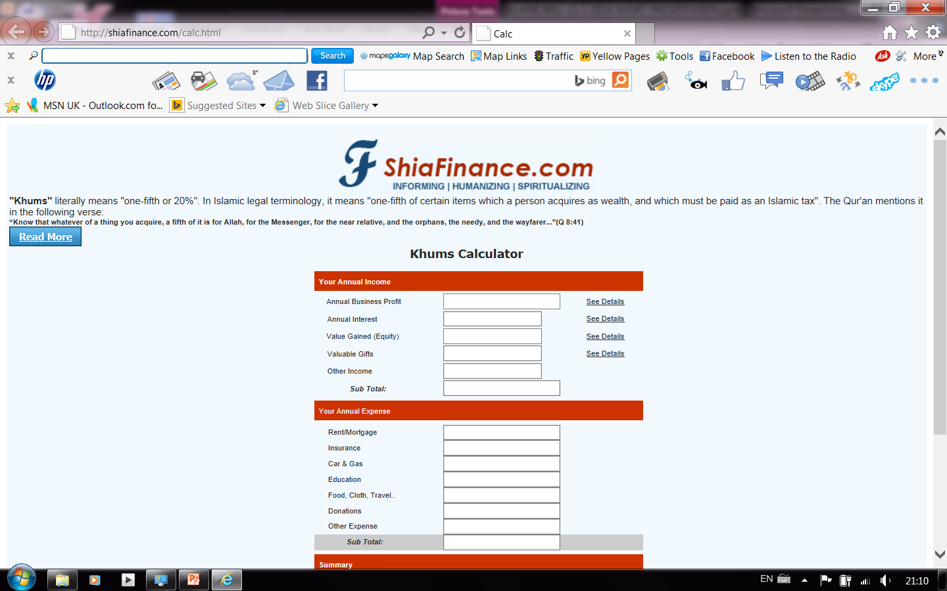
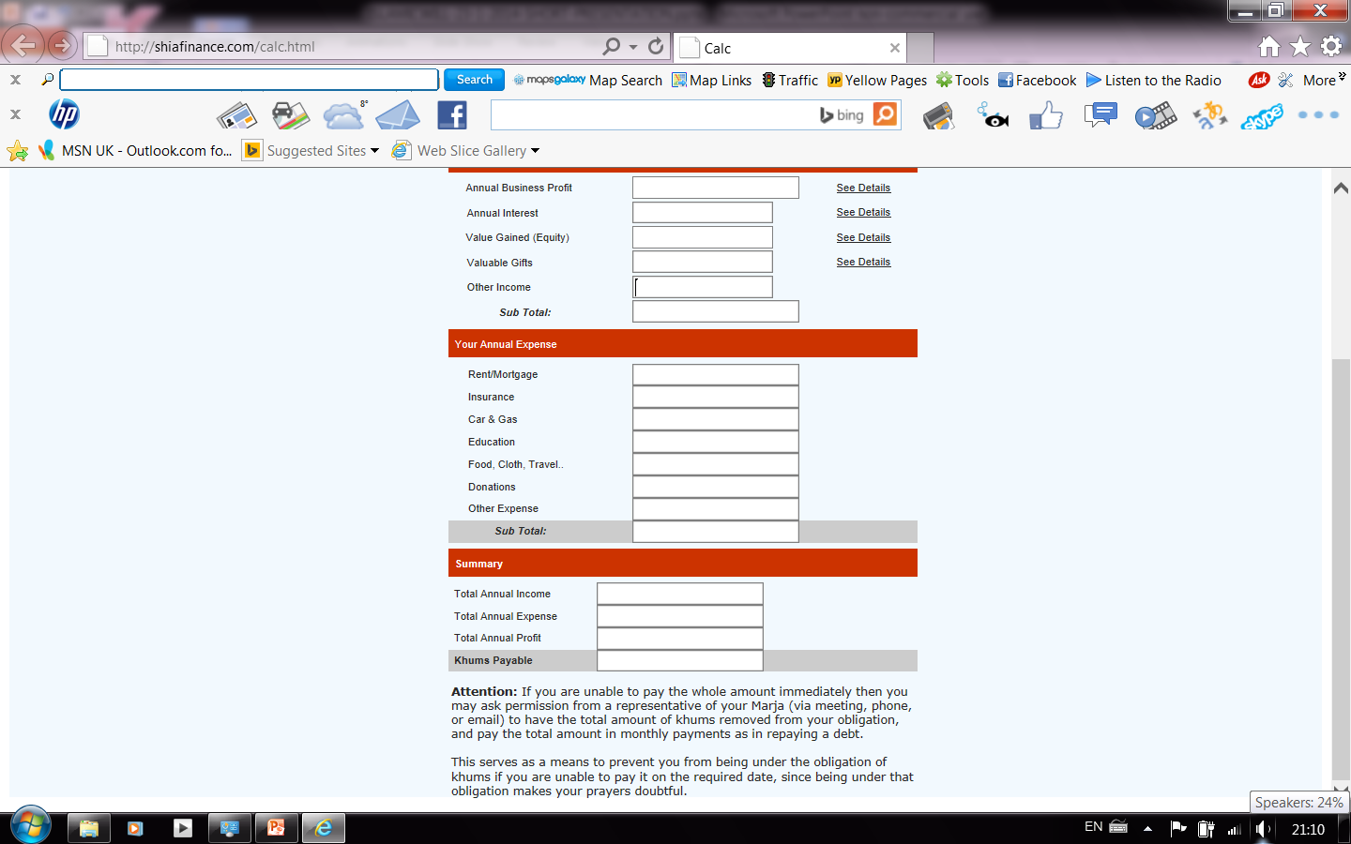
Epilogue
No “Shia (Jaa’fari) Irth” calculation software was found. A “Khums Tax calculation programme!” allegedly to fulfil Ayah 8:41 was found. According to the above website it translates as:
“Know that whatever of a thing you acquire, a fifth of it is for Allah, for the Messenger, for the near relative, and the orphans, the needy, and the wayfarer---”
The Arabic Quranic “Ayah 8:41” and it’s translation (see next slide) clearly specify through title (The Spoil or Booty), context and sequence that the “Khums” is not a tax paid annually to the local “Sayed” against income acquired through normal day to day work, but it is an ordained (20%) tax on spoils of war (booty) seized by Muslim Armies form defeated Kafers.
http://shiafinance.com/calc.html

Slide 52
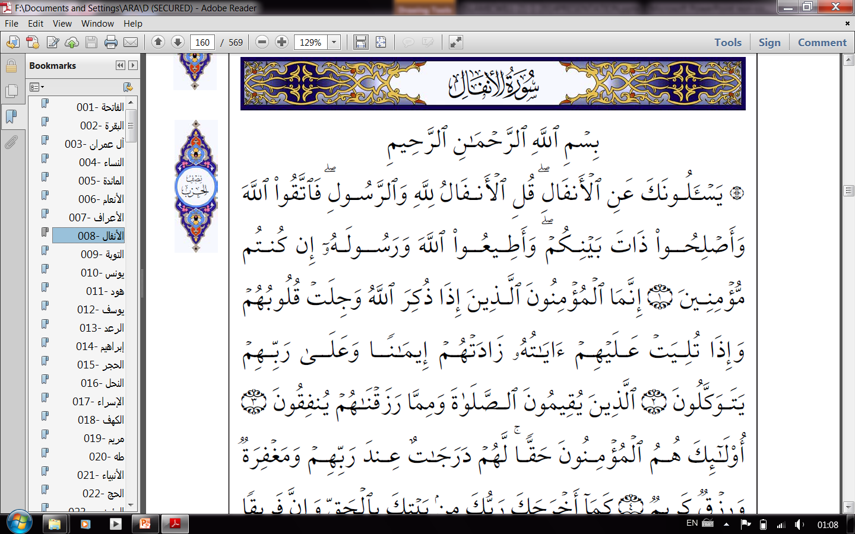
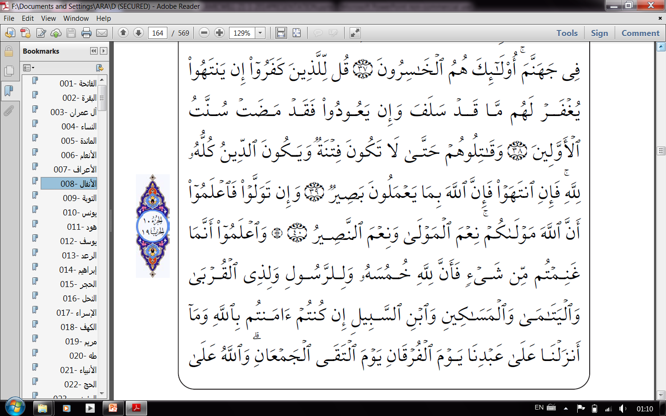
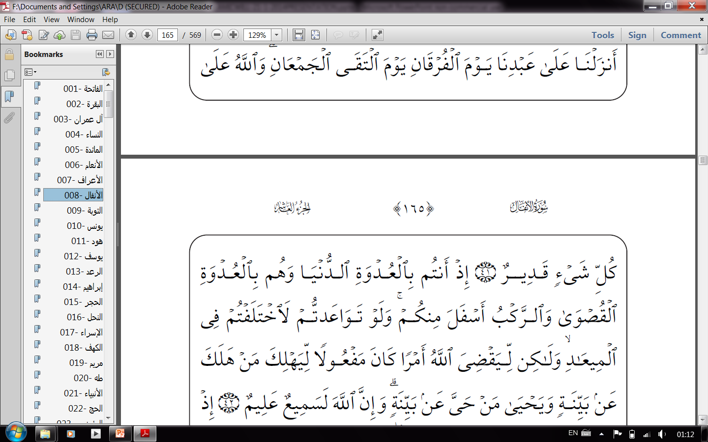
Surah 8:38-42, Al-Anfal (The Spoil)
Say to the unbelievers, if they give over He will forgive them what is past; but if they return, the wont of the ancients is already gone! 8:38
Fight them, till there is no persecution and the religion is God's entirely; then if they give over, surely God sees the things they do; 8:39
but if they turn away, know that God is your Protector -- an excellent Protector, an excellent Helper! 8:40
Know that, whatever booty you take, the fifth of it is God's, and the Messenger's, and the near kinsman's, and the orphans', and for the needy, and the traveller, if you believe in God and that We sent down upon Our servant on the day of salvation, the day the two armies encountered; and God is powerful over everything; 8:41
when you were on the nearer bank, and they were on the farther bank, and the cavalcade was below you; and had you made tryst together, you would have surely failed the tryst; but that God might determine a matter that was done, that whosoever perished might perish by a clear sign, and by a clear sign he might live who lived; and surely God is All-hearing, All-knowing. 8:42

